Slide 1

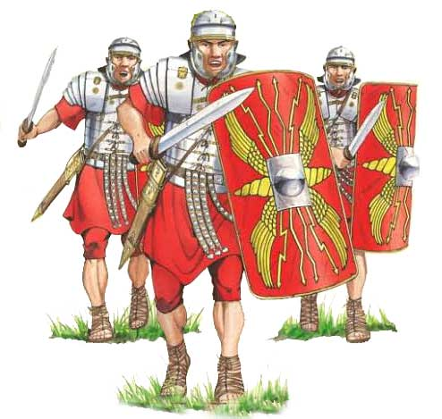
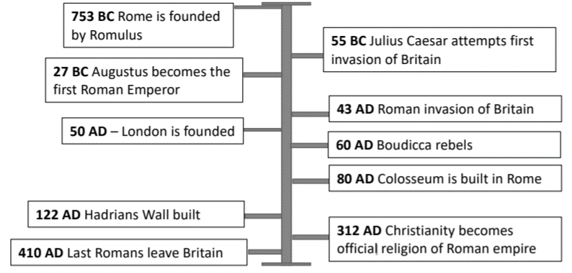

Victoria Primary School- History Knowledge Organiser
The Romans | Year 4
Key questions: Can you answer them all?
Why was Rome so powerful? Why did the Romans want to invade Britain? What buildings and events did the Romans introduce to Britain? How significant were the Romans for Britain? Why did the Roman empire Fail?
Key events |  | Details
First invasion of Britain | 55BC | Led by Julius Caesar but failed.
Claudius invades Britain | 43AD | Claudius leads the first successful invasion.
Rebellion against Romans | 60AD | Tribes lead by Boudicca attack Roman forces.
Romans leave Britain | 410AD | Romans leave Britain and return to Italy.
Important People
Emperor Claudius | First Roman emperor to successfully
Julius Caesar | Famous Roman leader who attempted to invade Britain
Boudicca | Saxon queen who fought back against the Romans
Paulinus | Roman governor (ruler) of Britain in AD60
Romulus and Remus | Mythical twin brothers, and founders of Rome.
Key Terms
Invasion | One country attacking to take it over.
Legion | One unit of the Roman army; 4000 to 6000 soldiers in. Lead by a centurion.
Emperor | The leader of an empire. Similar to a king or queen.
Amphitheatre | Where the Romans would go to be entertained.
Temple | A place of worship. A house of a Roman god or goddess.
Mosaic | One picture made up of thousands of small tiles (tessellates).
Senate | The Roman government.
What legacy did the Romans leave behind in Britain?
Language | Latin the official Roman language, forms the roots of many of our words
Buildings | Public baths, amphitheaters, temples can be seen around Britain
Names | We use Roman names for months (January, July) and planets (Mars, Jupiter).

Slide 2
Victoria Primary School- History Knowledge Organiser
The Romans | Year 4
Question Five : Explain why the Romans were so powerful.
2
marks
Question One : What did the Romans leave behind | Tick (more than one)
Baths
languages
temples
Religion
Names
Settlements
Question Six : Who was the first successful person to invade Britain? | Tick
Boudicca
Julius Caesar
Emperor Claudius
Romulus and Remus
1 mark
1 mark
Question Two: When did the Romans first invade Britain ? | Tick
410AD
55BC
55AD
Question Seven : Summarise and explain why and how Queen Boudicca rebelled
1 mark
2 marks
Question Three: What is a senate? | Tick
One country attacking another to take it over
The leader of an empire
The Roman government
Lead by a centurian
1 mark
Question Eight: When did the Romans leave Britain? | Tick
50AD
410AD
122AD
1 mark
Question Four: Why did the Romans want to invade Britain?
1 mark
Score out of 10___________________

