Slide 1
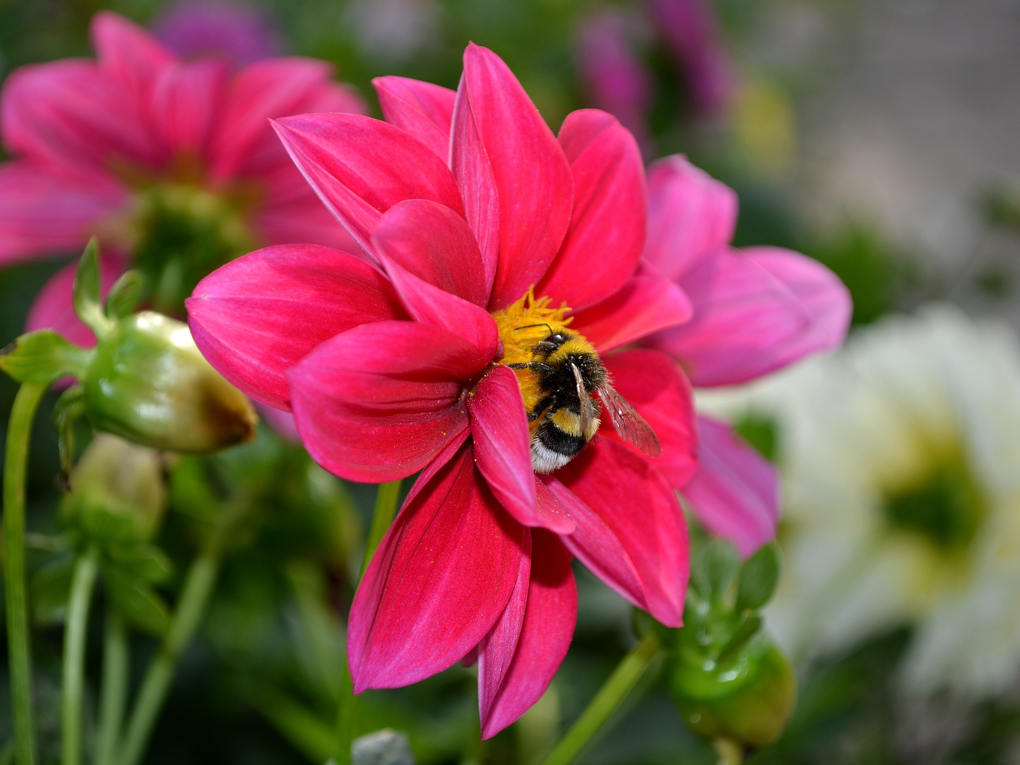
A bee on a flower!

Slide 2
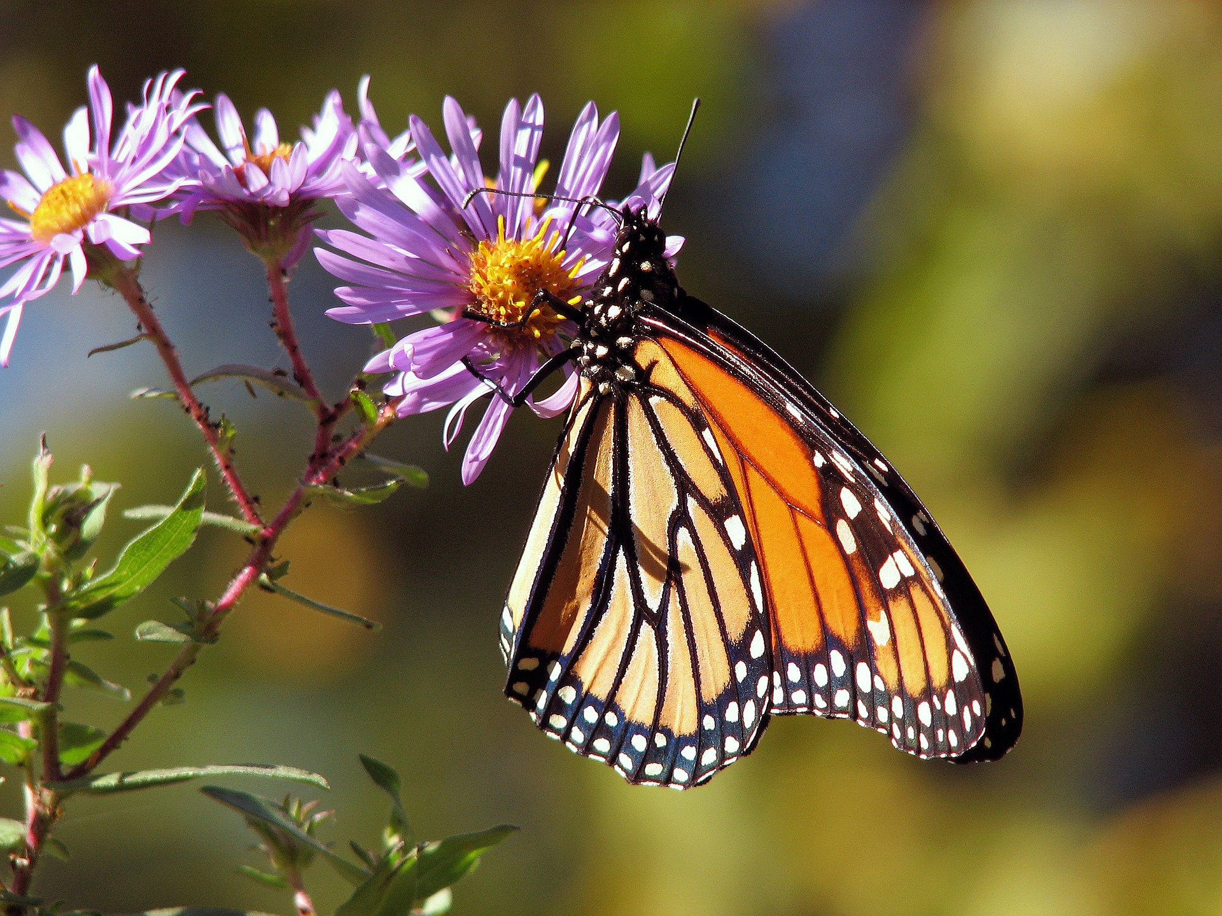
2
A butterfly!

Slide 3
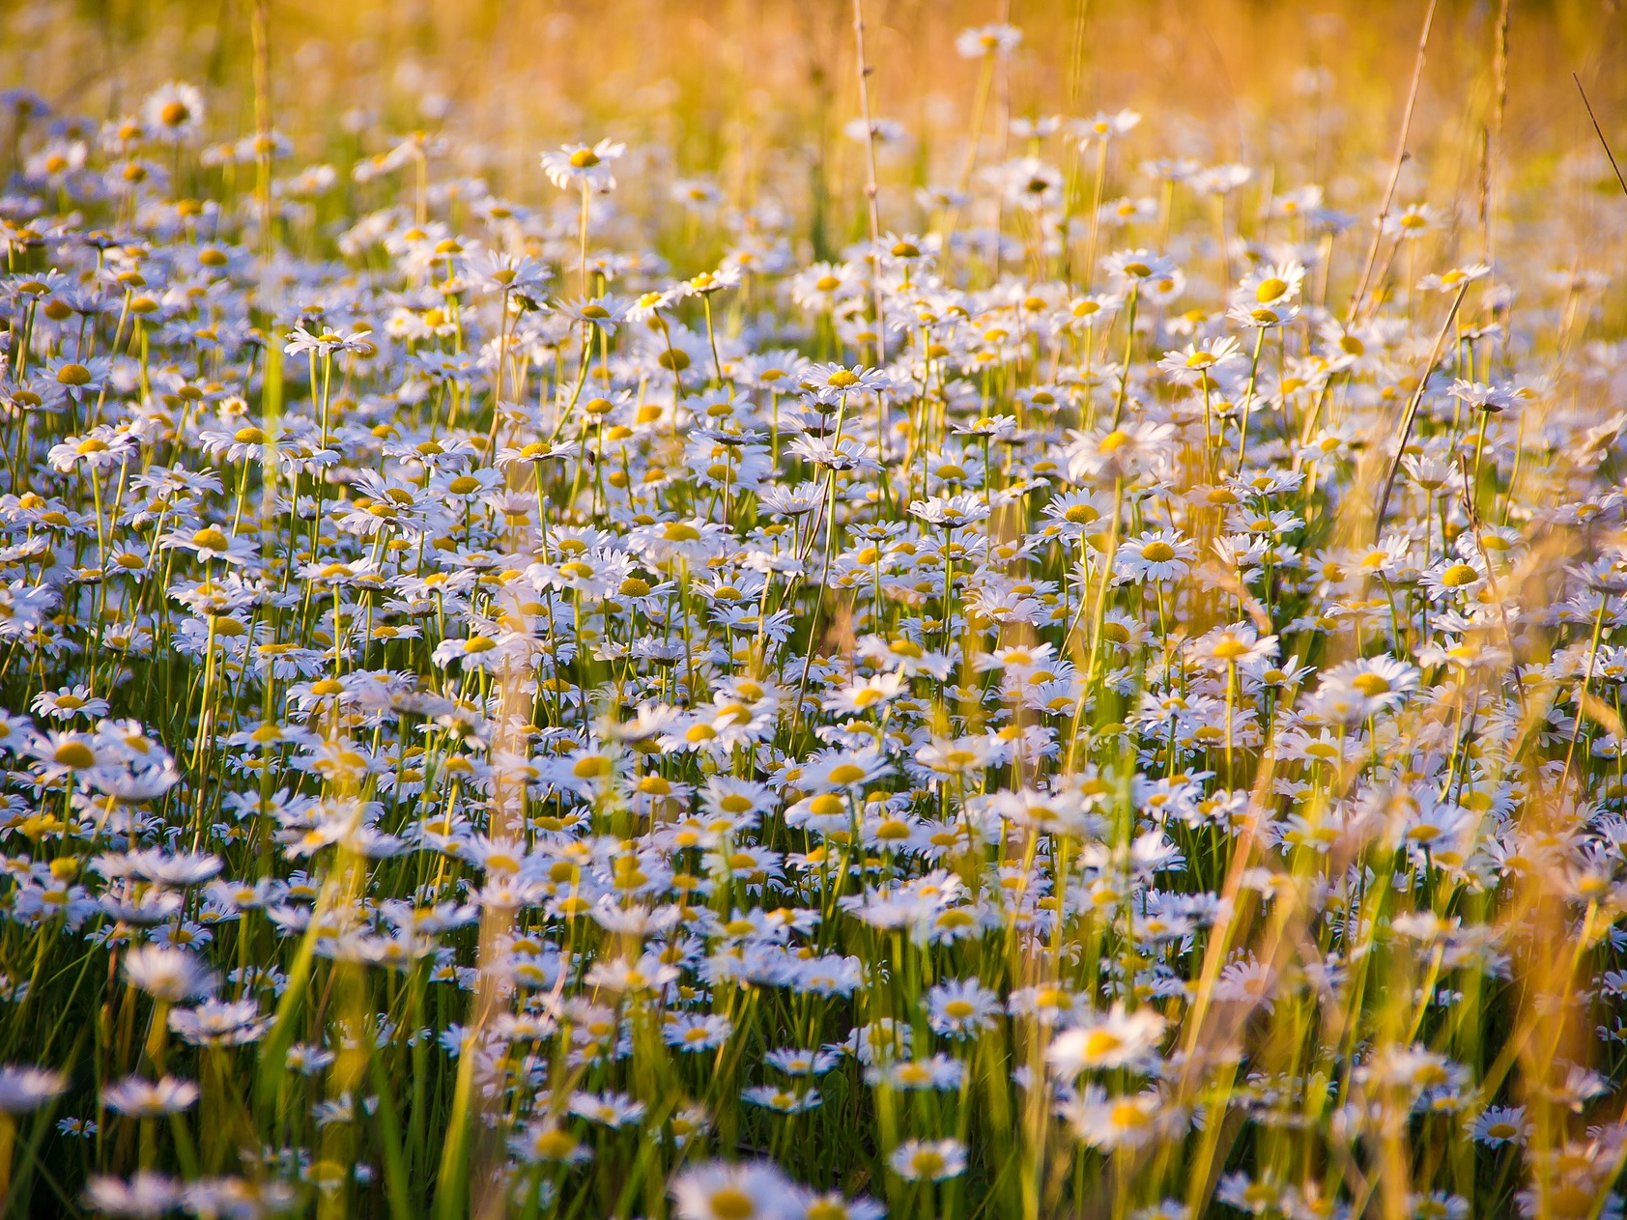
3
Daisies!

Slide 4
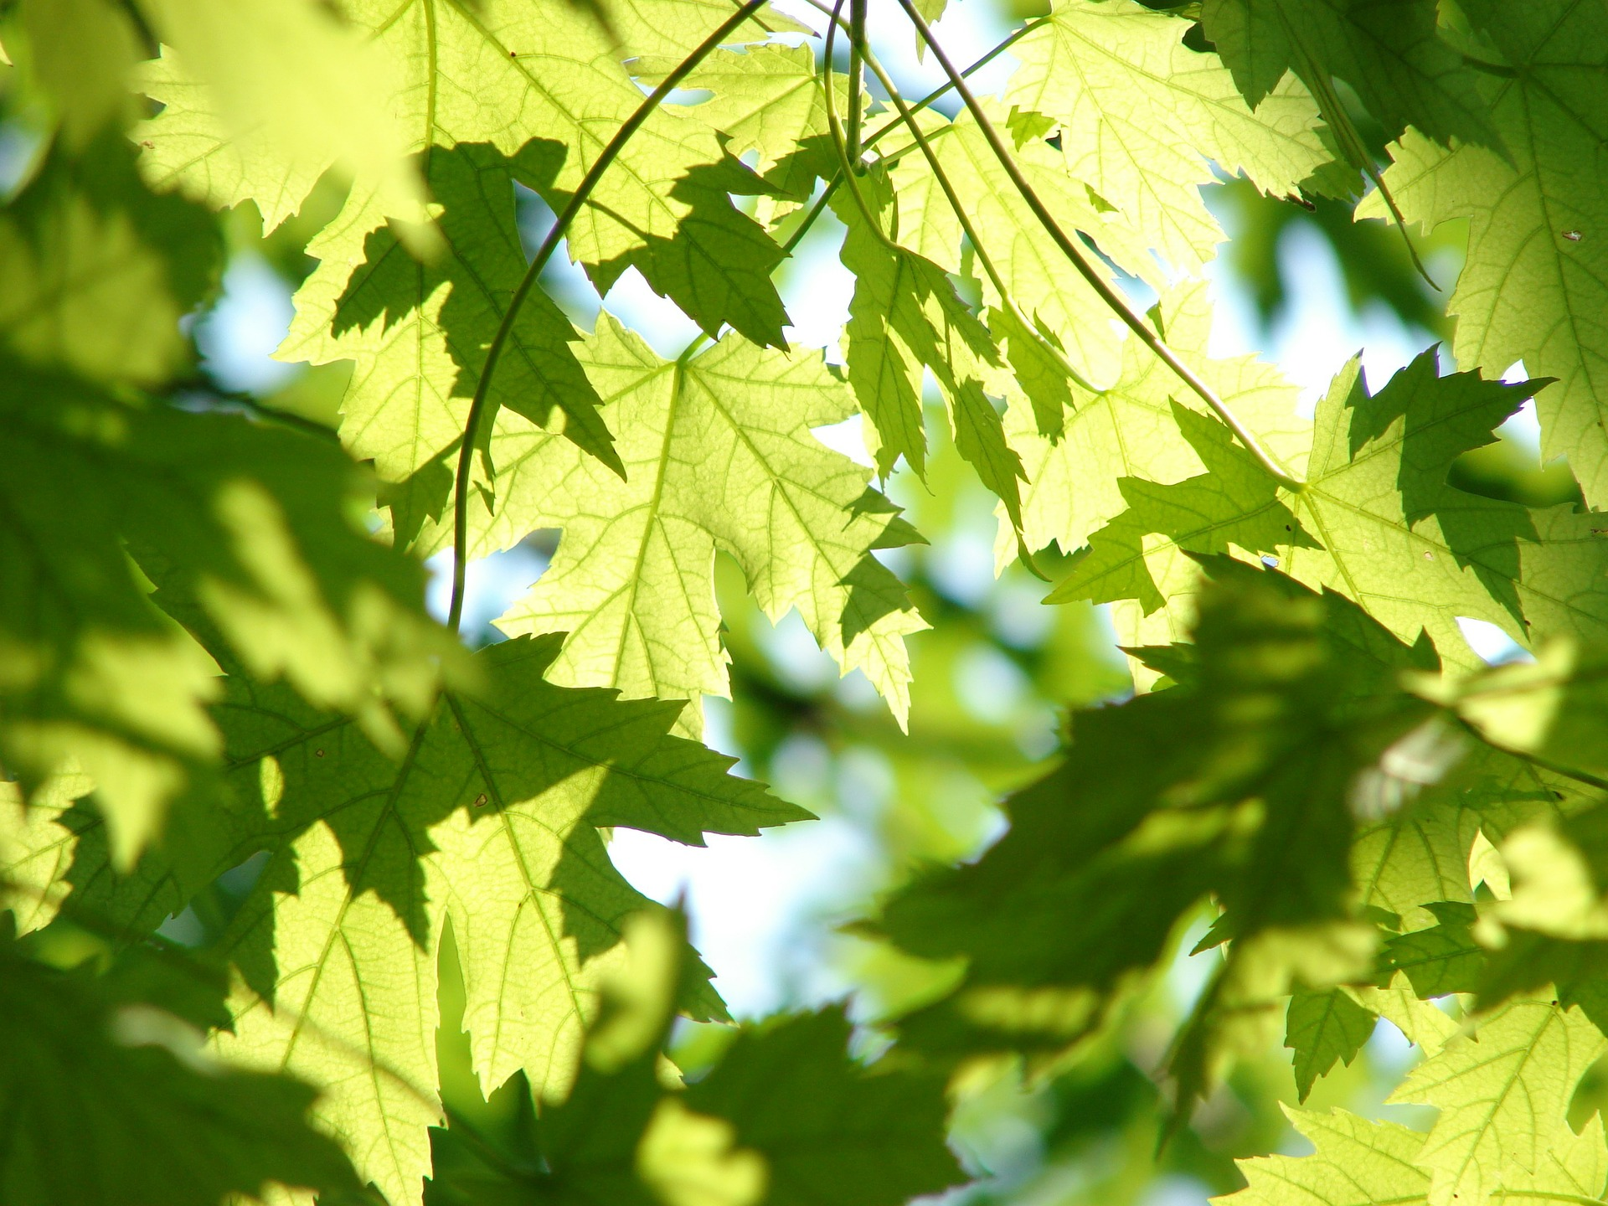
4
Green leaves!

Slide 5
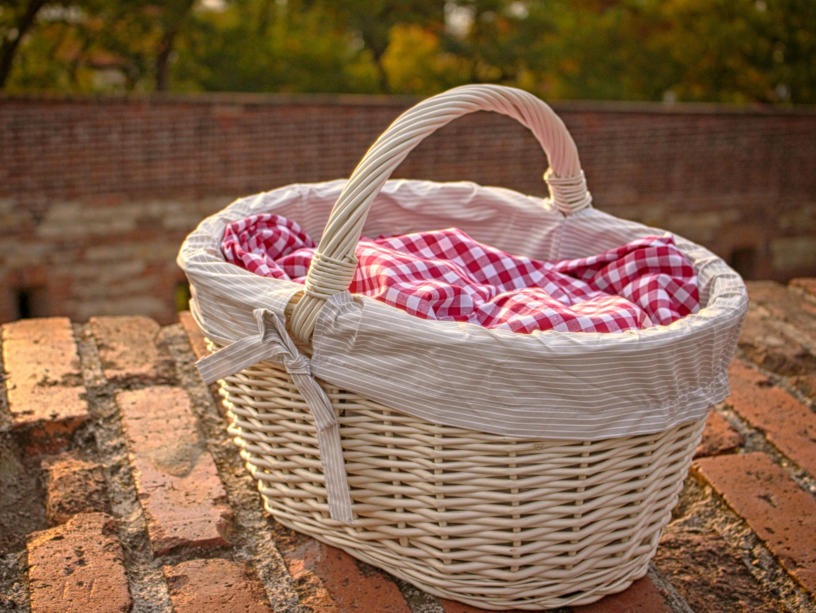
5
A picnic basket!

Slide 6
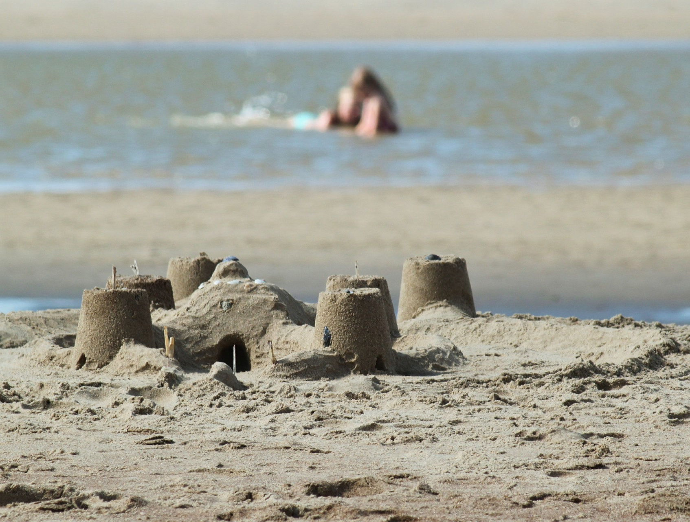
6
A sandcastle!

